Slide 1
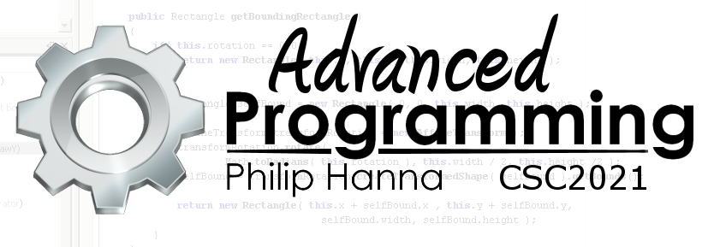
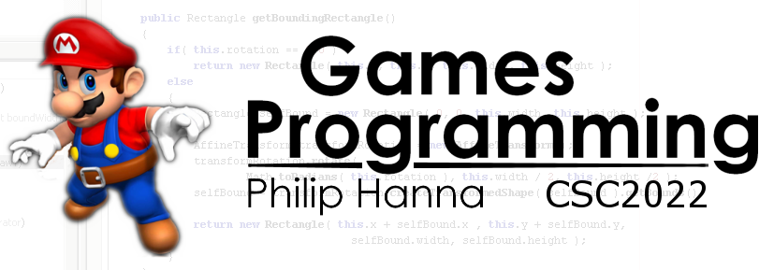
Steering Constraints and Path following
Constraining steering behaviours and following a determined path.

Slide 2

Path following

Slide 3
A path following behaviour will attempt to steer an object along some defined path. The object’s nearest location on the path is determined (this may be hard). Next, a target location further along the path is determined and used as the Seek target.
Seek output
Closest path point
Target path point
Aside: Arrive may be used for the final point (if the path is not a loop).

Slide 4
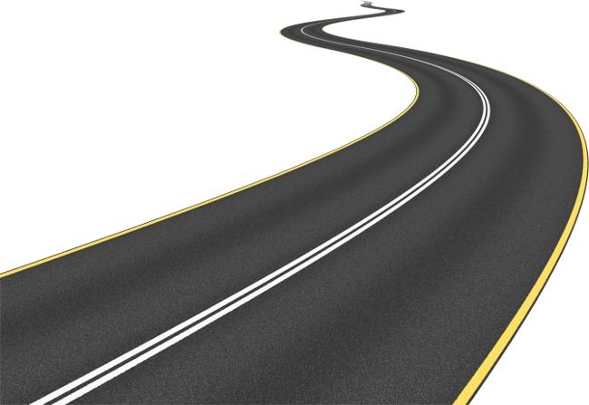
: Non-predictive
The basic delegating behaviour can be defined as:
FollowPath(
Object source, Path path,
float pathOffset ) {
float pathPosition = path.getPathPosition(source.position);
float targetPathPosition =
pathPosition + pathOffset;
Vector target =
path.getPosition( targetPathPosition );
return Seek( source.position, target );
}
path holds the Path object
pathOffset controls how far along the path the target position will be set
Determine the current position on the path
Move along the path and determine the world position of the new path position

Slide 5
: Predictive
FollowPath( Object source, Path path,
float pathOffset, float lookAheadTime,
float lastPathPosition )
Vector futurePosition = source.Position + source.velocity * lookAheadTime;
float pathPosition = path.getPathPosition(futurePosition, lastPathPosition);
float targetPathPosition = pathPosition + pathOffset;
Vector target = path.getPosition( targetPathPosition );
return Seek( source.position, target );
lookAheadTime how far ahead the position will be predicted
Predictive path predicts where the object will be in a short time, mapping this location onto the path.
lastPathPosition last path position

Slide 6
: Predictive Problems
Predictive path-following can be potentially problematic. However, by using the last path position and the principle of coherence the skip can be avoided.
Aside: Enforcing coherence is not always desirable (e.g. the object have may ‘teleported’, etc.).
Coherent path locations
Predicted location
Last path position
Seek output

Slide 7
: Simple Paths
Different means of defining a path can be used (including parametric curve functions).
A list of points provides a straightforward and effective path representation. Point spacing can be varied using the degree of curvature.
The integer path position is defined as the index of the closest point to the source.
An array of point-N-to-point-N+1 distances can be maintained to test for coherence.
Array<Point> pathPoints;

Slide 8
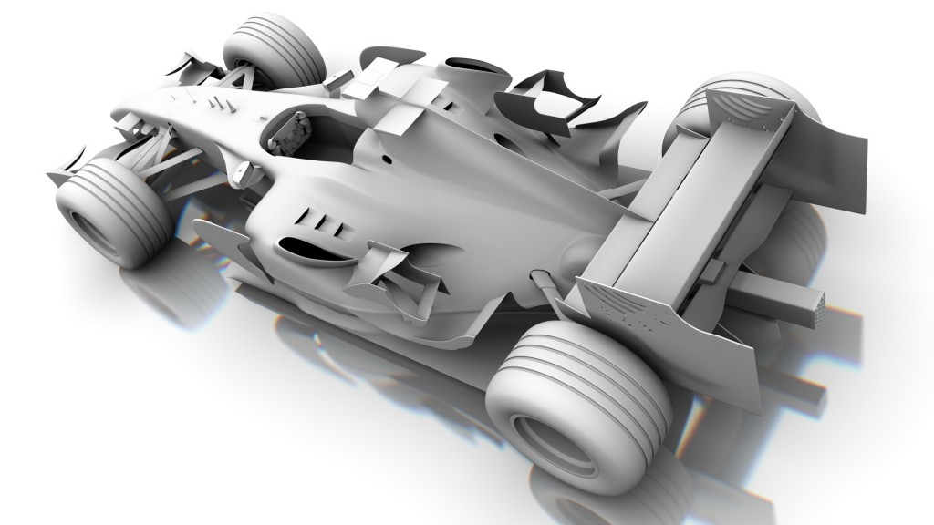
Constrained Movement

Slide 9
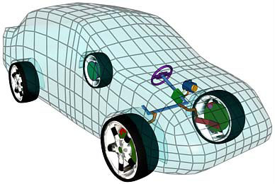
Steering behaviours provide movement requests, i.e. accelerations.
Some objects may not be able to immediately realise the request, e.g. a car can only accelerate forward / backward (with different rates) and has a turning rate that varies with movement speed. Different objects can have different behaviours.
In order to realise movement requests, a motor control layer can determine how best to execute a request, a process known as actuation.

Slide 10
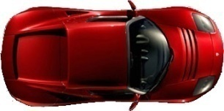
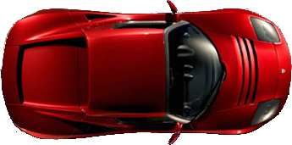
: Filtering
The simplest actuation approach is to remove all components of the steering output that cannot be currently realised.
Running the filtering algorithm every update tick (the steering output may remain constant) the object will move to match the steering target.
This approach is easily implemented, fast and reasonably effective, however, it can result in much smaller than requested accelerations (which can be detected and avoided if desired).
Achievable linear and angular acceleration
Requested
angular acceleration
Requested
linear acceleration

Slide 11
: Movement Arcs
Rear arc
Front arc
Vehicular movement can be constrained using movement decision arcs.
A forward arc in which the vehicle will turn towards the target without braking. A rear arc (with a max range) in which the car will reverse towards the target.
The arcs shrink based on speed and amount of grip. At low speeds the forward and rear arc touch (to prevent breaking deadlock at low speed).
If the target lies between the two arcs, then the vehicle will break and turn towards the target.
Maximum reversing distance
Breaking arc
Rear arc
Front arc
Breaking arc

Slide 12

Key takeaways:
Steering behaviours can be used with a path prediction algorithm to provide a path following behaviour.
By constraining the steering output it is possible to provide physically plausible constrained movement.

